Slide 1

Breast Cancer Detection
Marc Riley

Slide 2

Contents
Problem Statement
Data Source
EDA
Model Selection
Results
Limitation
Ethical Concerns

Slide 3
Introduction
Breast cancer is the growth of cells that cannot be controlled
This tumor can either be benign (not dangerous) or malignant (cancerous)
Each year nearly 2 million women are diagnosed with breast cancer
An inaccurate diagnosis can be fatal
Machine learning can look at a group of variables and determine if a tumor is malignant or benign quickly

Slide 4
Data Source/Characteristics
Data was provided by breast cancer patients in the state of Wisconsin
Data contains 600 images
32 variables
Symmetry
Concave points
Area
texture

Slide 5
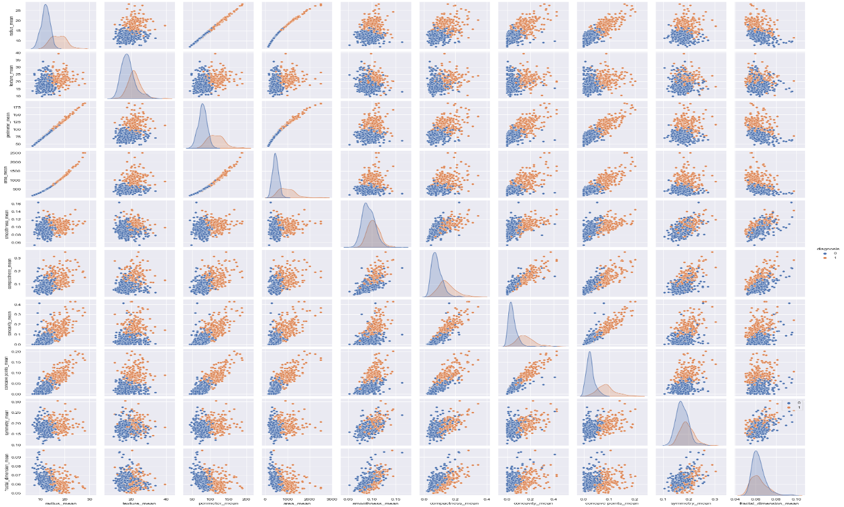
Data Analysis

Slide 6
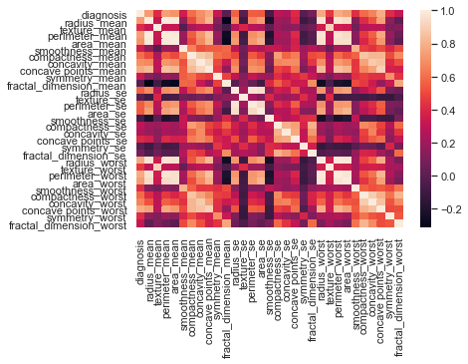
Data Analysis

Slide 7
Overview of EDA
Missing values addressed
Correlation chart plotted
Diagnosis column encoded and split
Outliers examined and removed
Distribution plotted

Slide 8
Model Selection
K-Nearest Neighbor
Quick run time
High accuracy
Sensitive to scale of the data
Sensitive to irrelevant features
Random Forest
Flexible
Works well with categorical and continuous values
Can fail to determine significance of each variable
Large data sets will take awhile to train

Slide 9
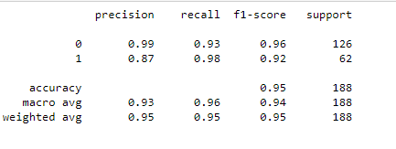
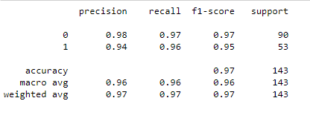
Results
KNN Model
Random Forest

Slide 10
Ethical Concerns
demographic information might be needed
Some groups of people might not have access to the technology needed to examine the cells
False positives while rare can be a concern
False negatives as well

Slide 11
Resources
https://www.kaggle.com/gargvg/breast-cancer-eda-classification/data
Lancet. Author manuscript; available in PMC 2018 Oct 16.
Published in final edited form as:Lancet. 2017 Feb 25; 389(10071): 847–860.
Published online 2016 Nov 1. doi: 10.1016/S0140-6736(16)31392-7
Smith. (2016, August 21). How does breast cancer get misdiagnosed or go undetected? Shevlin Smith. Retrieved January 27, 2022, from https://www.shevlinsmith.com/blog/2016/august/how-does-breast-cancer-get-misdiagnosed-or-go-un/

